Slide 1
Session 5 – Sankhya & Vaisheshika
(Dualism: The Nature of Mind and
Analysis of Aspects of Reality)
1) The Body of Desires and its impact.
2) Mysterious power of the mind.

Slide 2

The Dual model
Inferior Material Body
Superior Spiritual Body
3
Bodi
es
2. Subtle or (Body of Desires)
(Functions)
1. Mind
2. Intelligence
3. False Ego
Gross or (Precipitate Body)
(Elements)
1. Earth
2. Water
3. Fire
4. Air
5. Ether
3.Spiritual Body (Soul)
(Characteristics)
1. SAT (Eternal)
2. CIT (Knowledge)
3. ANANDA (Bliss)
Notes:
Example of Computer : Hardware, Software and User. Consciousness of the soul : 4 states : Jagrti, sushupti, svapna and samadhi.
Role of Attention done by the mind in coordination of internal cognition with the senses.

Slide 3
Superior Spiritual Body
3.Spiritual Body (Soul)
(Characteristics)
1. SAT (Eternal)
2. CIT (Knowledge)
3. ANANDA (Bliss)
Eg Computer Game
    Hardware
    Software
    Person
    Has to identify with some thing in game!
    Eg. Cricket game

Slide 4
3 States of Consciousness
  Awake (Jagruti)
  Dreaming (Swapna)
  Coma (Sushupti)
Importance of body of desires
When soul leaves body it leaves it along with body of desires..
And continues journey
Body of desires is common between bodies
Eg. James the pilot
Suicide is no solution as one has to continue

Slide 5
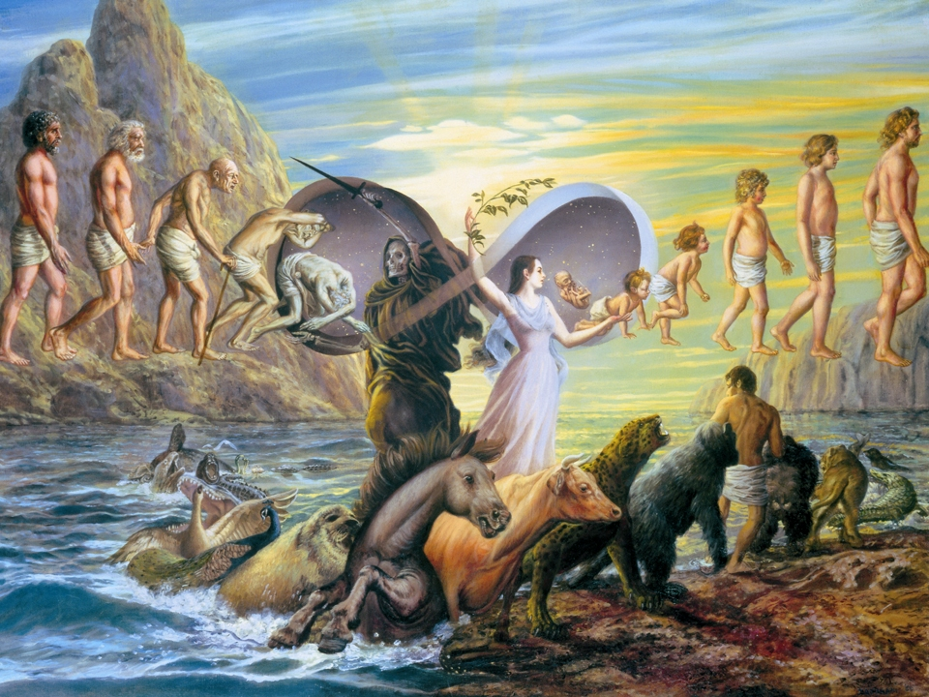

Slide 6
How does on get a new body
Ans It depends on body of desires..
According to body desires, external body precipitates out.
Eg. Person watching movie…

Slide 7
As per the development of the body of desires by ones free choices
Ones next body is determined
Eg. Shop in South east asia selling blood
Pigeon
Polar bear
Every body is responsible for ones current state of existance

Slide 8
What happens to one at Death as per Sankhya?
The soul leaves the gross body behind and is taken to another
womb based on the quality of desires stored in his subtle body
at the time of death.
Human body is like a junction..
“As a person puts on new dresses, giving up old ones, the soul similarly accepts new material bodies, giving up the old and useless ones.” [Gita 2.22]
Notes:
Different bodies suitable to different desires : examples : Human form importance. Traffic signal. Drinking blood : Mosquito.

Slide 9

On what basis,
the soul is awarded
The next body?

Slide 10
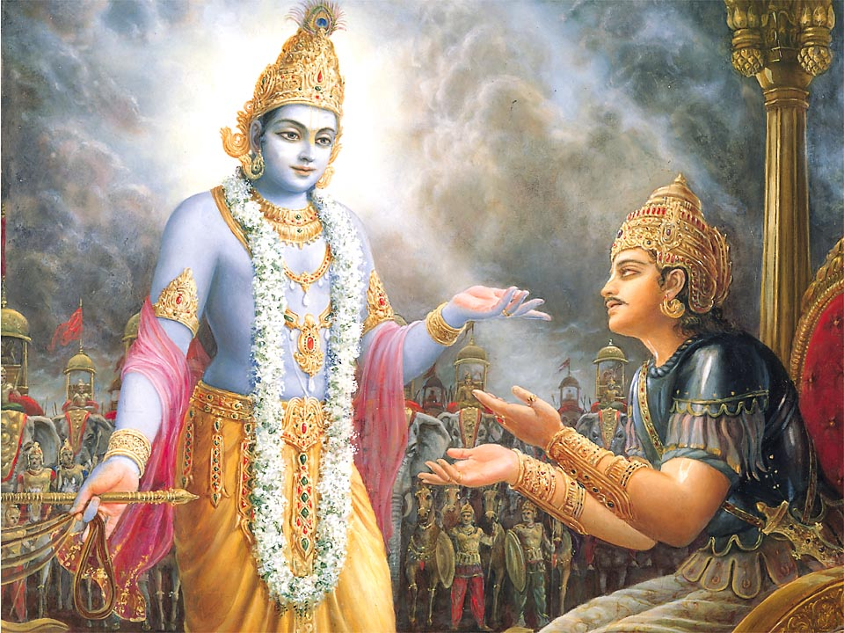
Krishna says in the Bhagavad-gita (8.6),
“Whatever state of being one remembers when he quits his body, O son of Kunti, that state he will attain without fail.”
Notes:
Gita as observational science.

Slide 11
Theory of Shkhya is- Your state of consciousness never expires
Nature gives on opportunity to fulfill all dreams and aspiration and deisres.. Repeatedly and in different circumstances..

Slide 12
Logic for the existence of Body of Desires.- I
Like the soul, the mind is atomic and indivisible -- there is one in each body.
The existence of the mind is not perceived but is inferred from the following propositions.
First, it is apparent that external sense faculties are necessary for the perception of external objects of the world.

Slide 13
Logic for the existence of Body of Desires.- II
Likewise, an internal sense faculty is required for the perception of internal objects, such as soul, cognition, feeling, pleasure, pain, and so on.
Eg Pills for hormone secretion is not complete solution
The mind is this internal sense faculty. Second, it is apparent that the five external senses may all be in contact with their respective objects simultaneously, but not all of these perceptions are received at the same time.

Slide 14
Logic for the existence of Body of Desires.- III
This demonstrates that there must be some other agent besides the external senses that both limits the number of received perceptions to one perception at a time and that orders the perceptions in sequential succession. eg
In other words, although two or more external senses may be simultaneously receiving data, only that which is being attended to is actually perceived.

Slide 15
Logic for the existence of Body of Desires.- IV
Attention therefore represents the coordination of the mind with the senses, and every perception requires the contact of the mind with an object by means of the senses.
Additionally, if the mind were not a partless entity, then there would be simultaneous contact of many parts of the mind with many senses, and many perceptions would subsequently appear at one time. The fact that this never happens proves that the mind is a partless, atomic, and internal sense faculty of perception.

Slide 16



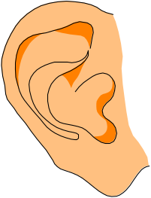

MECHANISM OF THE MIND
INTELLIGENCE
THE DECISION
MAKER
THE SENSES
EYES
NOSE
TONGUE
MIND
STOREHOUSE OF THOUGHTS,
UNFULFILLED DESIRES,
PREVIOUS EXPERIENCES
EARS
SKIN
Notes:
Repeating pleasurable experience

Slide 17
Functions & Characteristics of the Mind
Accepting & Rejecting (Sankalpa/ Vikalpa)
Introduction to the definition of Yoga
Friend or enemy (eg Knife)
Neglect as a weapon to deal with whims. (Buddhist understanding)
Source of happiness and distress. (Story of Alexander and the Saint)
Mind as the taster of mellows.
“Idle mind as the devils’ workshop”
The five Kosas
Notes:
Examples of advertising and attachment of the mind with what it associates.

Slide 18
5 Koshas
Physical Annamaya
Life Air Pranamaya
  Interface between body and mind is life air
Mind Manomaya (emonational)
Intellinence Vigyanamaya
Bliss Anandamaya

Slide 19


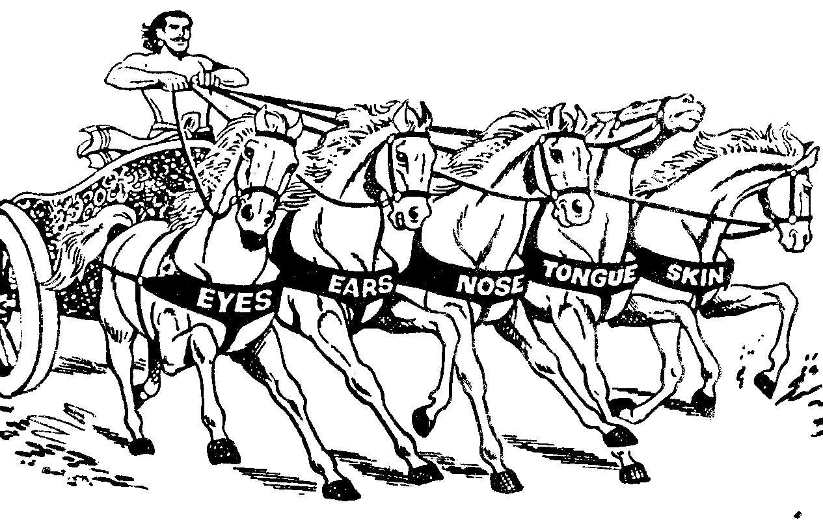
CHARIOT OF THE BODY
SOUL
INTELLIGENCE
MIND
5 SENSES

Slide 20






NATURE OF
THE MIND
IF IT IS
CONTROLLED
IF IT IS
UNCONTROLLED
IT IS YOUR BEST FRIEND
IT WILL BE YOUR GREATEST ENEMY

Slide 21
“For him who has conquered the mind, the mind is the best of friends; but for one who has failed to do so, his mind will remain the greatest enemy.” { Gita 6.8 }

Slide 22



Can The Mind Be Our Friend?
MIND IS COMPARED TO A KNIFE.
Is The Knife Good Or Bad ?
In A Surgeon’s Hand : It Can Save Life !
In A Miscreant’s Hand: He Can Kill With It !!

Slide 23

Uncontrolled Mind: What It Can Do To You
LACK OF CONFIDENCE
DEPRESSION
STRESS
LOSS OF TRUST
HYPERTENSION
MADNESS
DAMAGE TO ONESELF, FAMILY AND SOCIETY
DANGEROUS DISEASES
WEAKENED DETERMINATION
Disturbed Senses, Fickle Mind
& Lusty Intelligence

Slide 24
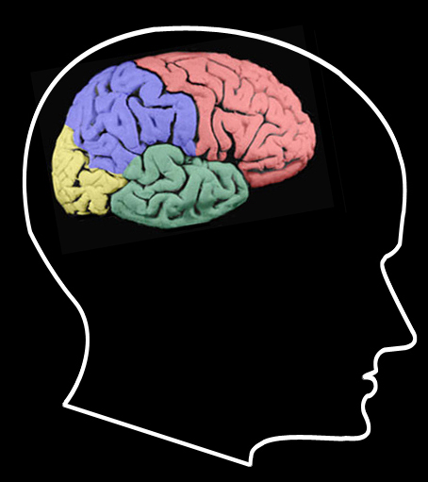
Techniques for Mind Control
Do not allow the senses to wander stray in any direction they want.
Withdraw them from wrong engagements. {Tortoise Example}

Slide 25
Thank You

